Slide 1
IMPRO

Slide 2
Objective:
The objective behind developing IMPRO is to maintain the hierarchy of the employees within an organization. It provides the manger and administrative department an overall hierarchical view of the complete enterprise and helps them in managing employees.

Slide 3
Description:
Every Organization has many managers, who are responsible for all the activities in the organization. These managers manage different aspects of the organizational management issues, such as manufacturing, production, Marketing, etc

Slide 4
Features
Finding ground level employee performance by the topmast manager.
Maintenance of profile details of the employees, and retrievals as and when required.
Overall & detailed view of the organization hierarchy, which is very much essential in making effective decisions.
Judging the potentiality of the employees.
Maintenance of the data when the organization has many branches spread over wide geographical area.
Accessing one branch information from another branch.
Future planning issues based on the current HR information.
Employees success planning.
Vacancy situations and their priority /effect on the organizations performance.
Employee motivational & conflict resolving issues.

Slide 5
We need to consider while doing the project.
The user should be provided with all information of the employee details.
User friendly interface with minimal training
intranet based application
provide hierarchical view of the organization
provide facilities for future planning

Slide 6
SOFTWARE REQUIREMENTS:
Operating system : Windows 2000 or later
Front End : VB.Net
Back End : SQL Server 2000
HARDWARE SPECIFICATIONS:
Processor : Intel Pentium or more
Ram : 128 MB or more
Cache : 512 KB
Hard disk : 16 GB hard disk recommended

Slide 7
Modules
Master
Org Details
Weighate
Authentication
Reports

Slide 8
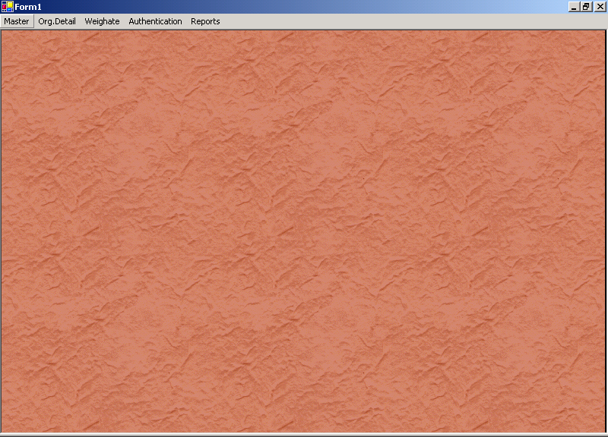

Slide 9
Details
Employee Creation
Employee hierarchy
Department entry
Live status
Employee list enumeration
Process details
Job rotation
Position Weightage
Vacancies maintenance & process details

Slide 10
Employee Creation
In the Hierarchical Organization Information System each employee is created with their corresponding
    department,
    designation and
    section details.

Slide 11
Employee hierarchy
In this system Administration department is the Root Department, under which different departments exist. So the Employment hierarchy will start with root department head like chairman and subsequently the department employees with dept head and section employees with their section employees and for sub departments in the departments can be identified.

Slide 12
Department entry/department hierarchy
In this module, Master Data for the departments can be created employees refer this data .Sub departments Can be identified .Some of The departments will have Different Sections
Each Department having Department heads ,so department employees should reported to the department head he may be subordinate to his superior Department he shall report to him. some of departments having sections so section employees shall be reported to the section in charge he shall report to the department head.
From this Departments, sub departments the Department hierarchy shall be created.

Slide 13
Live status
Live status gives accurate information about which Employee, will work in which section his superior employees or his subordinates can be identified along with their corresponding departments so that the employee info can be managed easily.
Their performance can be monitored and if need they can be deputed to other department as and when required this can be effectively managed.

Slide 14
Employee list enumeration
The employee details already in the database so the details can be retrieved as and when required by taking the selective criteria from the HR manager.

Slide 15
Process details
Employee hierarchy can be created using Employers and their superior’s information.
Department Hierarchy can be created using the departmental interdependencies.
Vacancy list in various departments can be identified and prioritized by calculating the position weight-ages.
Employees can be transferred from one department to another based on different criteria provided by the HR manager.
Employee retention can be processed depending their performance.

Slide 16
Job Rotation
Job rotation process will be invoked when the employee experiences monotony in his work / duty. These will result in poor performance, some times leads to major errors in the field of operation. This can be overcome by job rotation process. In this the employee will be moved to other department of interest, so that the employee will work with renovated vigor and vitality.
In some cases, to fill up the emergency vacancies, job rotation process will be executed to avoid unforeseen delays. In any case along with the candidate / employee his credentials and other associates will be passed to the destination department.

Slide 17
Position Weightage
Position weightage will be calculated based on Departments weightage, section weightage and even the designation weightage. Each position in the organization will have certain importance in the functionality of the overall organization. The weightage of the each position will be calculated by using the actual position in the organization and as well as the position in the authority flow.

Slide 18
vacancies details and process details
Vacancies raised in various departments can maintained by filling the new employees or by shifting/additional charges to existing employees.

